Slide 1
Distinguishing Humans from Other Primates
ANSC 110
Crystal A. Allen PhD

Slide 2
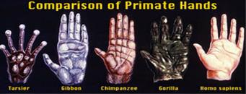
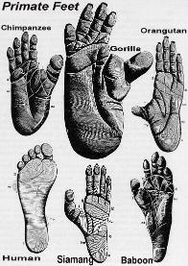
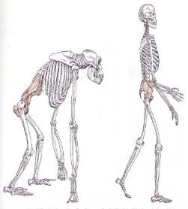
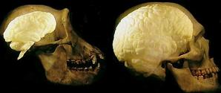
Physical Differences
Hair
Hands/Feet
Larynx
Skeleton
Brain

Slide 3
Behavior Differences
Bipedal
Monogamous
Advanced cognition
Possibly not breastfeed
Tool making

Slide 4
Advanced Cognitive Abilities
Language
Imagination
Thinking about obscurity
Reflection
Art

Slide 5
Social Differences
Monogamy
Cooperation
Common goal for common good

Slide 6
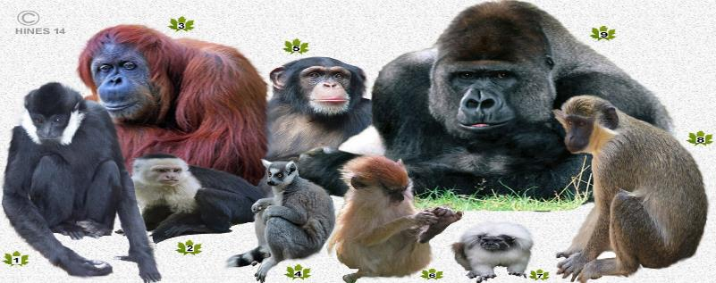
PRIMATES
ANSC 110
Crystal A. Allen PHD

Slide 7
Objectives
Discuss Ape Genius
Recognize physical differences (human vs primates)
Recognize behavioral differences (human vs primates)
Recognize cognitive differences (human vs primates)
Distinguish between apes and monkeys

Slide 8
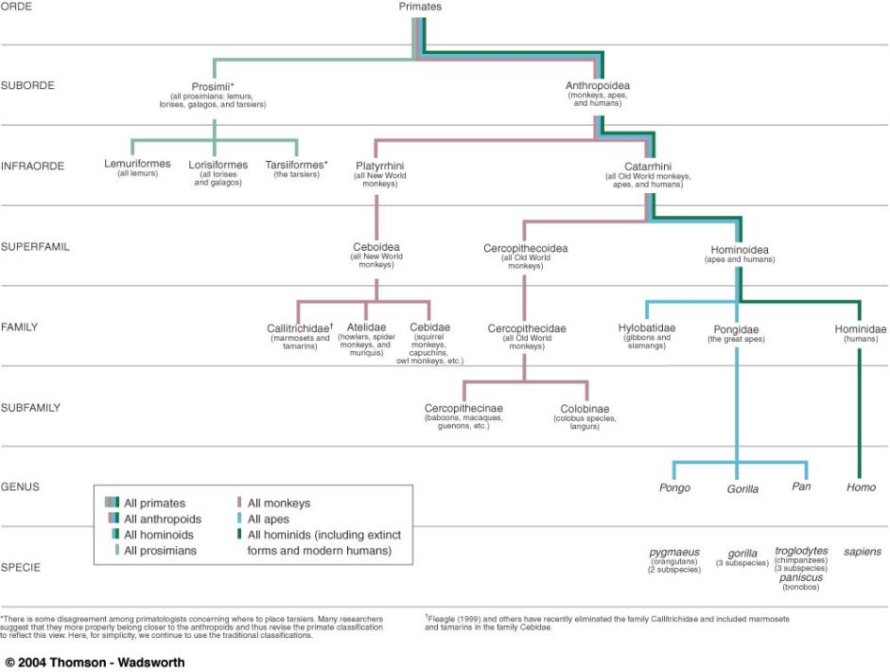

Slide 9
Animal Classification
Kingdom-Animalia
Phylum-Chordata
Class-Mammalia
Order-Primates
Suborder-Proimii and Anthropoidea
Family
Subfamily
Genus
Species

Slide 10
PRIMATES
A mammal of the order Primates, which includes the anthropoids and prosimians, characterized by refined development of the hands and feet, a shortened snout, and a large brain.
Any member of the group of animals that includes human beings, apes, and monkeys — primate in a sentence.

Slide 11
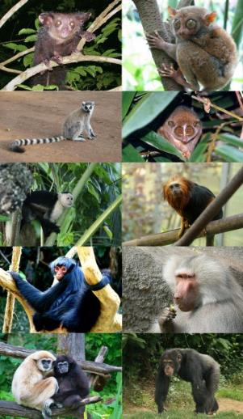
Primates

Slide 12
Suborders
Prosimii- Lemuriformes (lemurs)
- Lorisiformes (lorises, galagos)
- Tarsiliformes (tarsiers)
Anthropoidea- Platyrrhini (New World Monkeys)
- Catarrhini (Old World Monkeys, apes, humans)

Slide 13
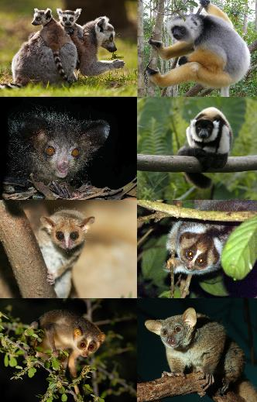
Prosimii

Slide 14
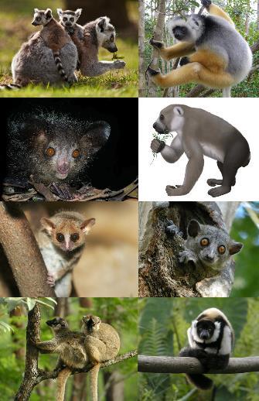
Lemurs (Lemuroidea)

Slide 15
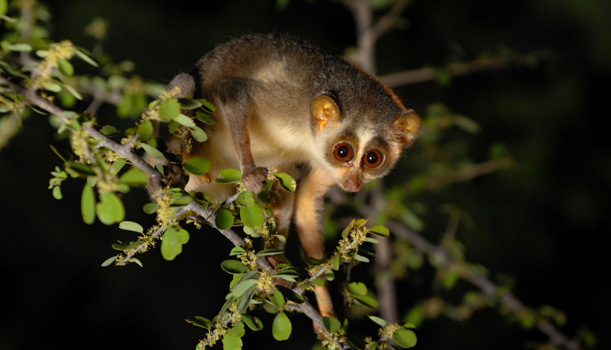
Lorises (Lorisoidea)

Slide 16
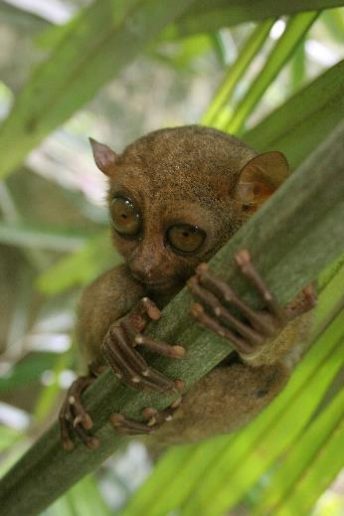
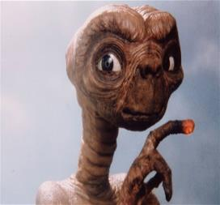
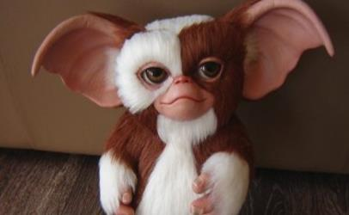
Tarsiers (Tarsiiformes)

Slide 17
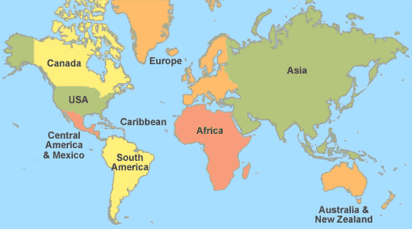
Anthropoidea-Platyrrhini
New World Monkeys
Central/ South America
Marmosets, tamarins, howlers, spider monkeys, squirrel monkeys, capuchins

Slide 18
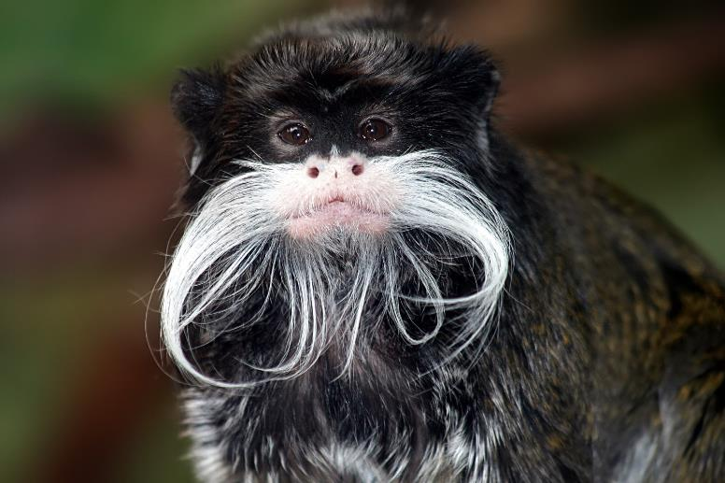
Tamarins

Slide 19
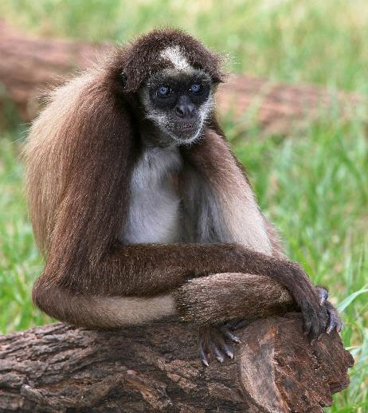
Brown Spider Monkey

Slide 20
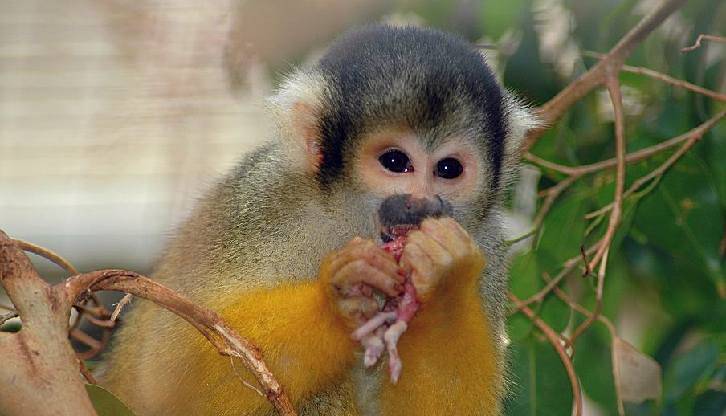
Squirrel Monkey

Slide 21
Anthropoidea-Catarrhini
Africa/Asia
Old World Monkeys
Apes
Humans

Slide 22
Old World Monkeys
Baboons
Macaques
Guenons
Colubus
Langurs

Slide 23
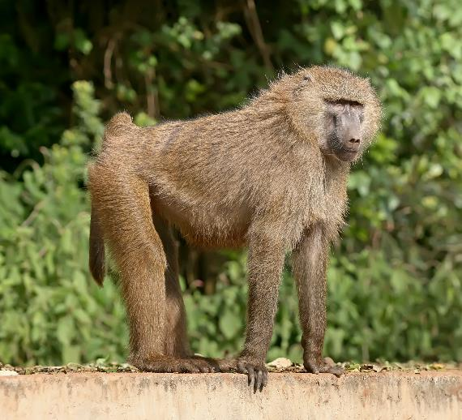
Old World Monkeys-Olive Baboon

Slide 24
BABOONS
2-2.5 FT. TALL WHEN STANDING
20-80#, MALE-50# (UP TO 110#), FEMALE-30#
LIFESPAN-30 YEARS (WILD), 35-45 YEARS (CAPTIVITY)
GESTATION-6 MONTHS
LIVE IN TROUPS OF 15-150, FEW MALES, FEMALE DOMINANCE
OMNIVORES
EAT PLANTS, INSECTS, SMALL MAMMALS (RODENTS, HARES, FOXES, SMALL ANTELOPE), BIRDS

Slide 25
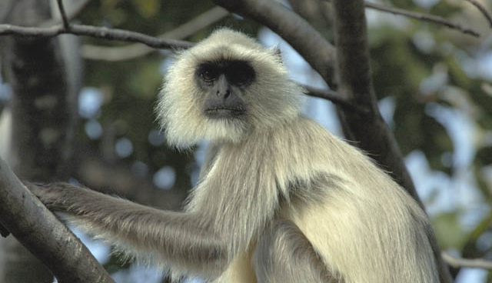
Langurs

Slide 26
Apes
Gibbons
Slamangs
Great Apes-Orangutans, Gorillas, Chimps, Bonobos
Humans

Slide 27
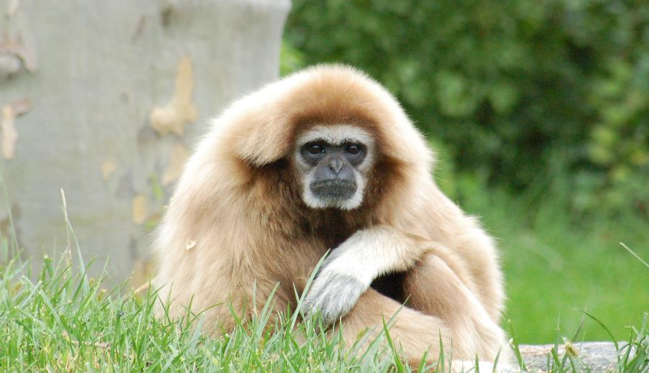
White-handed Gibbon

Slide 28
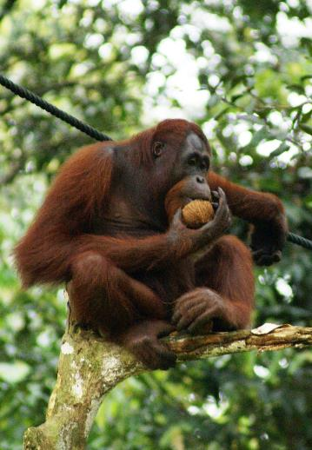
Borneon Orangutan

Slide 29
ORANGUTANS
Name means “forest person”
Indonesia, Borneo, Sumatra
Said to be most intelligent
Solitary
100#, 4-5 ft. tall
35-45 years, 60 in captivity
9 month gestation
Foragers-mostly fruits, insects, bird eggs
Endangered

Slide 30
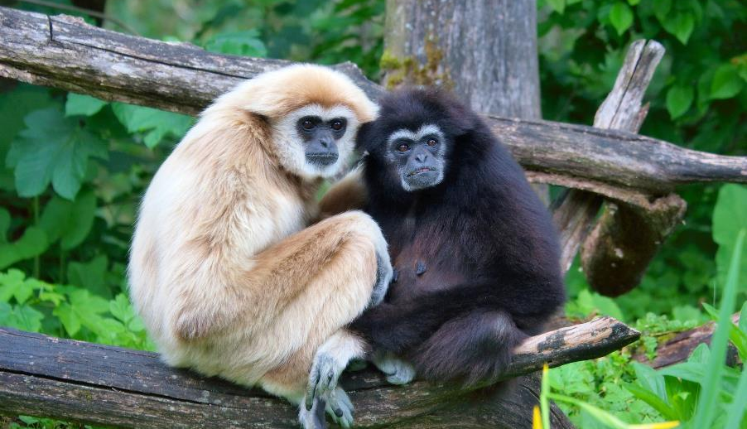
Gibbons (Hominodea)

Slide 31
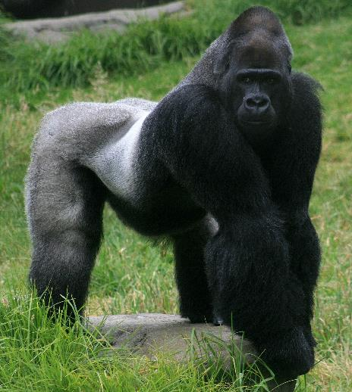
Silver Back Gorilla

Slide 32
GORILLAS
Africa
Troop-1 male, few females
300-400#, 5.5-6 ft. tall
9 month gestation
35-40 year lifespan, 50 in captivity (58 oldest)
Eats leaves, stems, fruit
Silverback-12 years or older

Slide 33
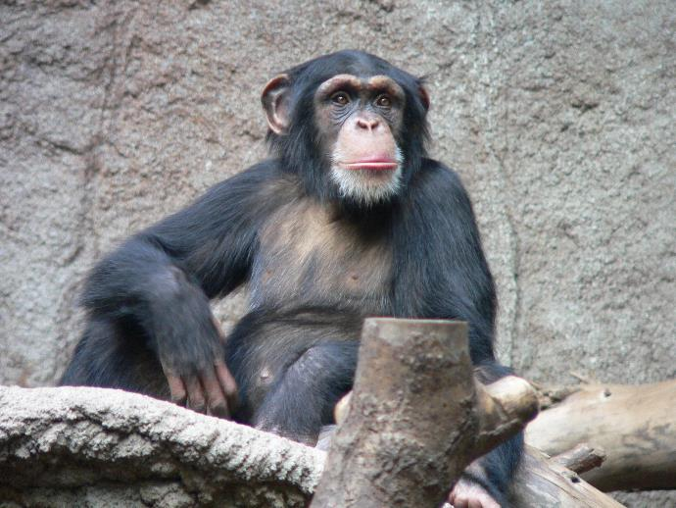
Chimpanzees

Slide 34
CHIMPANZEES
Name means “mockman”
Africa
Troop-multiple males and females, up to 150
Lifespan 50 years in captivity
Omnivores
80-150#, 3-4 ft. tall
1961 sent into space

Slide 35
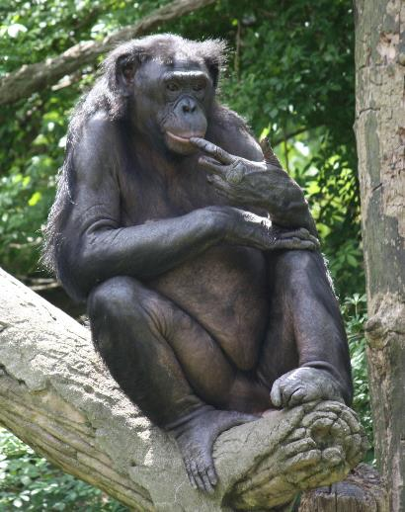
Bonobos

Slide 36
BONOBOS
Only found in Congo
Troop up to 150
Only apes that don’t kill, non aggressive
Omnivores
75-150#, 3-4 ft. tall
40 years in captivity
Matriarchal
Frequent sex, make-up sex
Females are promiscuous, paternity uncertain
Last of great apes to be discovered
https://www.youtube.com/watch?v=sN-Hj73ES2U

Slide 37
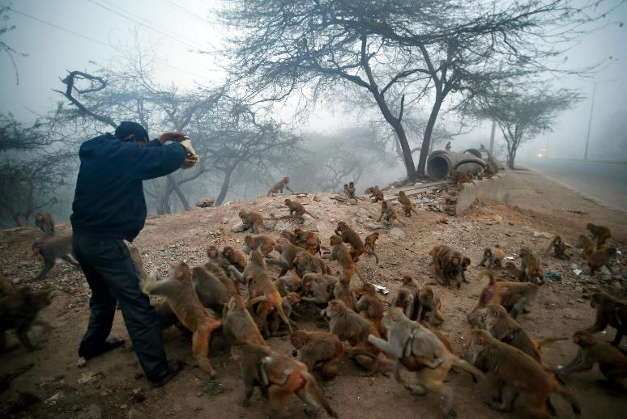
WILD MONKEYS IN INDIA

Slide 38
FAMOUS APES & MONKEYS
HOW MANY CAN YOU NAME?

Slide 39
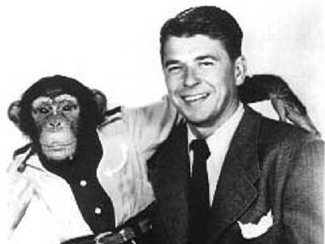
BONZO

Slide 40
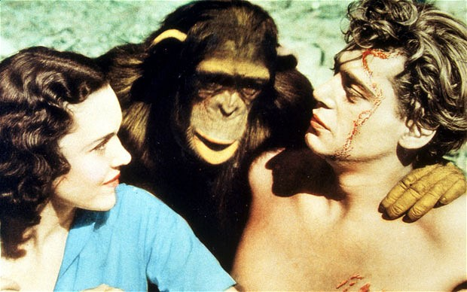
CHEETA-TARZAN

Slide 41
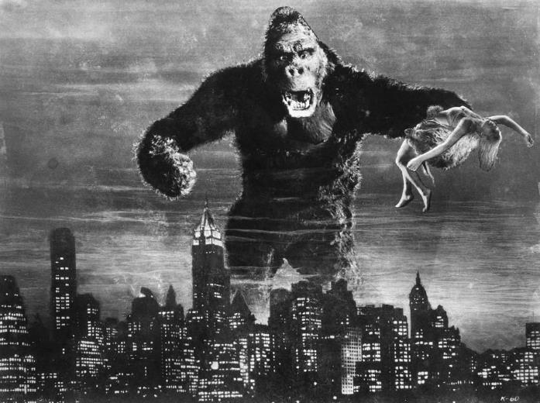
KING KONG

Slide 42
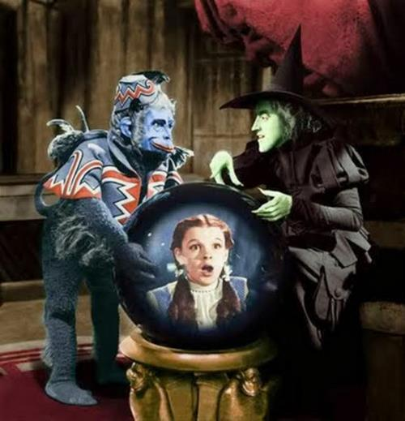
FLYING MONKEYS-WIZARD OF OZ

Slide 43
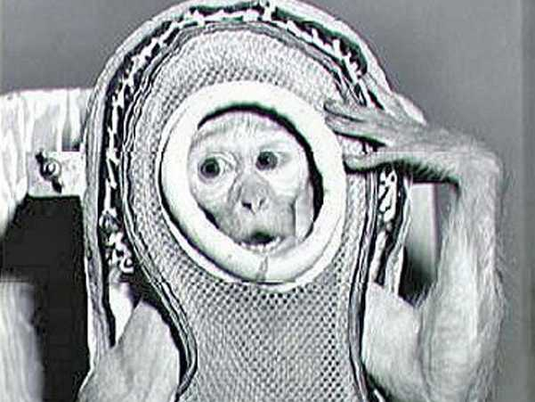
ALBERT

Slide 44
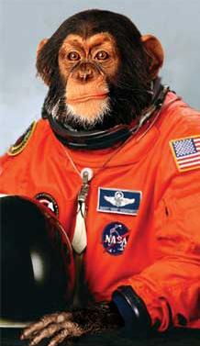
HAM

Slide 45
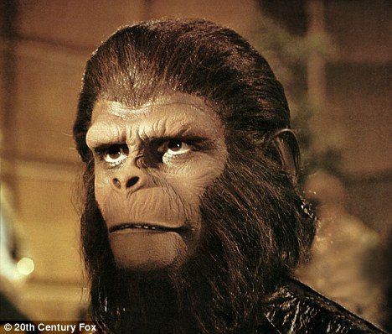
PLANET OF THE APES

Slide 46
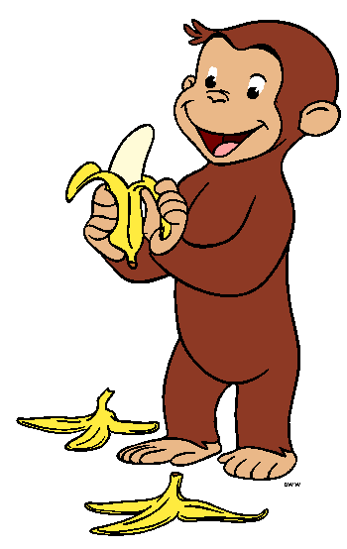
CURIOUS GEORGE

Slide 47
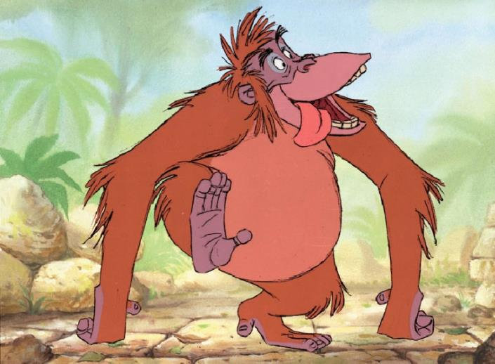
KING LOUIE-JUNGLE BOOK

Slide 48
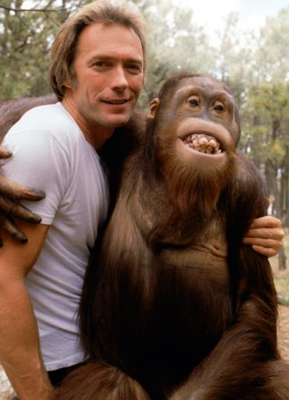
CLYDE-ANY WHICH WAY BUT LOOSE

Slide 49

DONKEY KONG

Slide 50
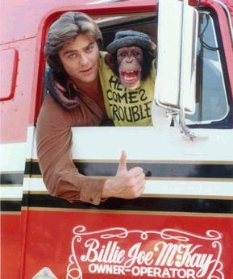
BEAR-BJ AND THE BEAR

Slide 51
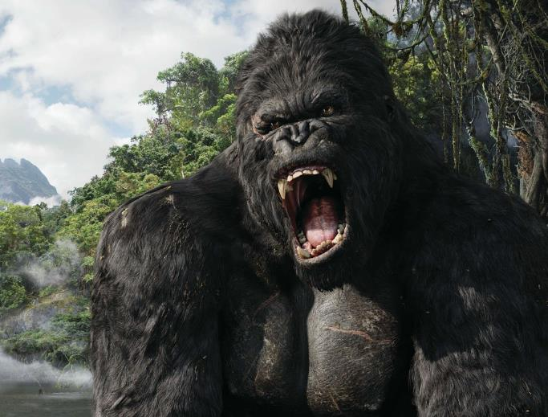
MIGHTY JOE YOUNG

Slide 52
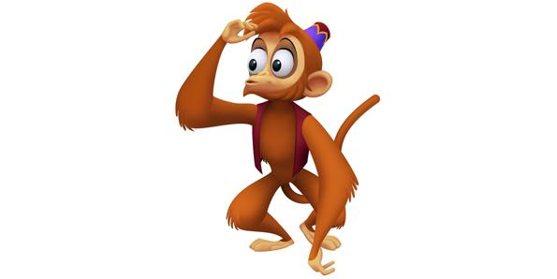
ABU-ALLADIN

Slide 53
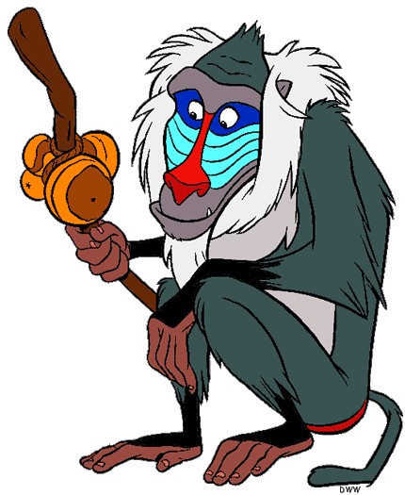
RAFIKI

Slide 54

THE MONKEES
http://www.dailymotion.com/video/xudz3o_hey-hey-we-re-the-monkees-youtube_people

Slide 55
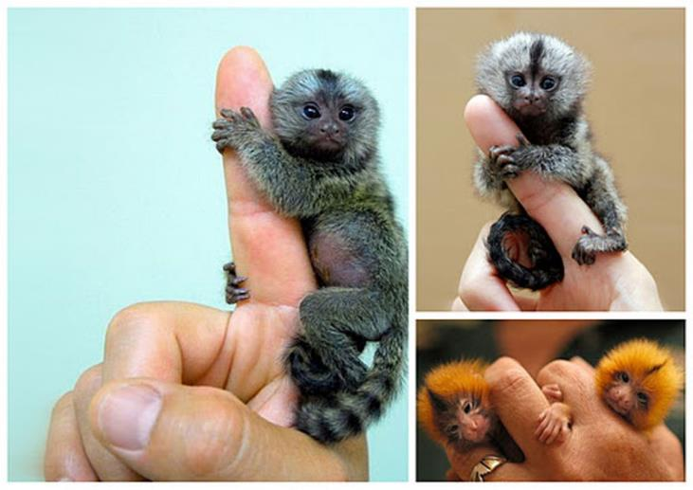
PET MONKEYS

Slide 56
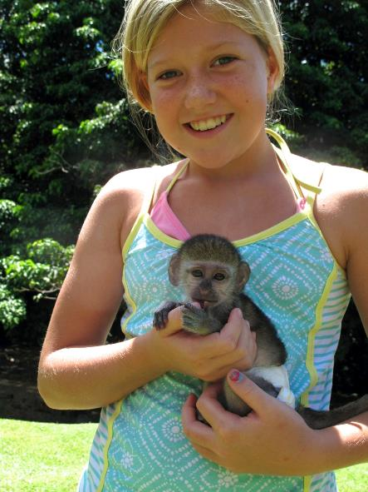
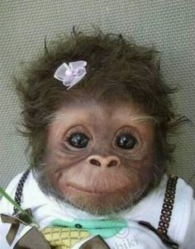
PET MONKEYS

Slide 57
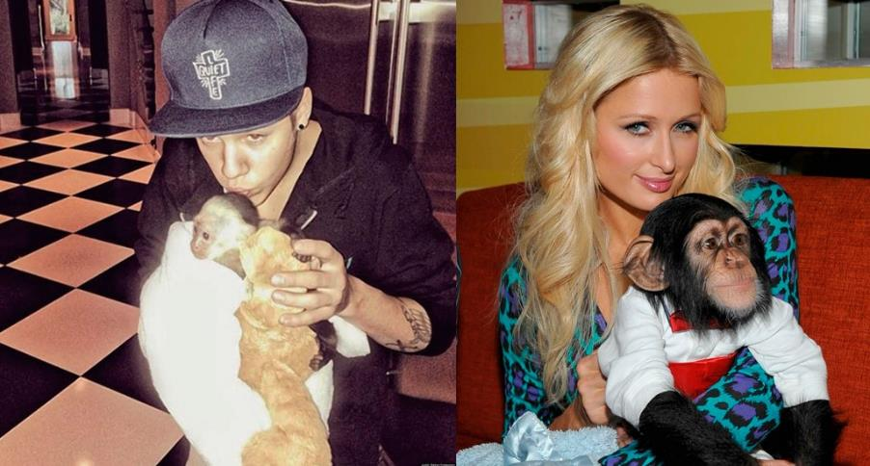
CELEBRITIES & APES/MONKEYS

Slide 58
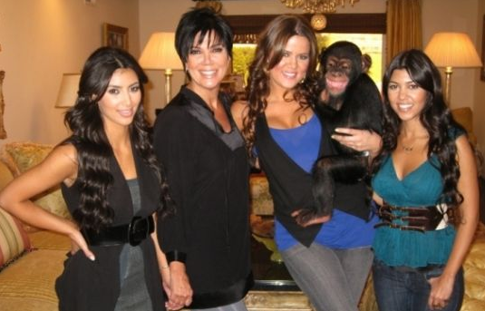
CELEBRITIES & APES/MONKEYS

Slide 59
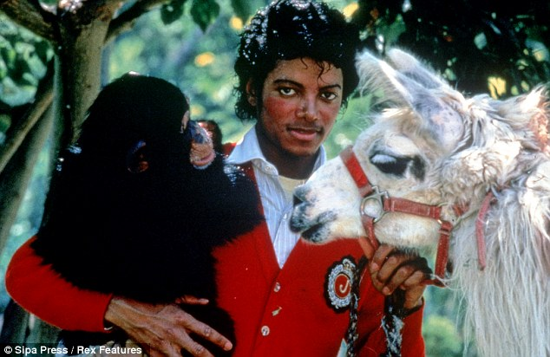
CELEBRITIES & APES/MONKEYS

Slide 60
Do Not Have a Pet Ape or Monkey
NEVER
NEVER
NEVER

Slide 61
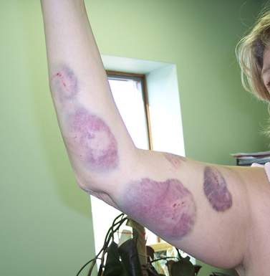
MONKEY ATTACK

Slide 62
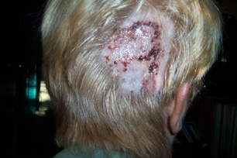
BITE FROM APE

Slide 63
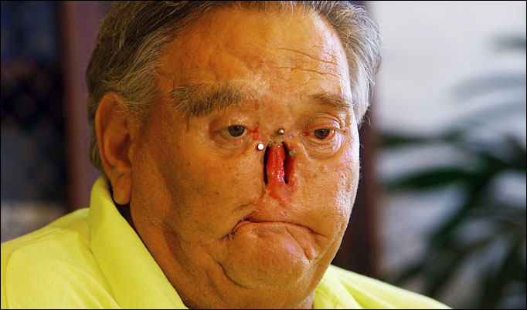
NOSE BITTEN OFF BY CHIMP

Slide 64

Chimp Owner

Slide 65
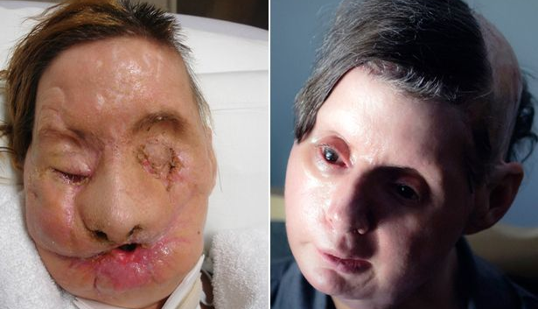
After Chimp Attack

Slide 66

BEFORE & AFTER

Slide 67
Questions?

